Slide 1

Detecting Obesity Level
With Predictive Modeling
BUS AN 516 | Team 9 | Hyewon Jeong, Samvit Patankar, Lucy Tsai, Weihan Weng, Yoey Zhang

Slide 2
Table of Contents
Introduction
Research Purpose and Questions
Data Overview & Details
Data Exploration
Predictive Models and Findings
Summary

Slide 3
Introduction
Project Overview: Analyzing factors affecting obesity levels across Mexico, Peru, and Colombia by examining dietary habits, physical activities, lifestyle, and demographic factors. Constructing predictive models aimed to identify individuals at high risk of obesity.
Motivation & Audience : Obesity is a significant global health concern, impacting individuals' well-being. By understanding the factors that cause obesity, healthcare professionals and policymakers can make informed decisions to prevent and manage the issue effectively.
Notes:
The goal is to develop predictive models to identify individuals at high risk of obesity.
43% of adults are overweight and 16% are living with obesity

Slide 4

Research Purpose and Questions

Slide 5
Research Purpose & Questions
Can we accurately predict obesity levels based on dietary habits, physical activity, lifestyle, and demographic factors?
What are the key factors influencing obesity levels?

Slide 6

Data Overview & Details

Slide 7




Dataset Overview
Total number of records: 2111, no missing values
Source
Scope
Timespan
Mexico, Peru, and Colombia
Assumed to represent a snapshot at the time of data collection
Kaggle
Collected via survey at a web platform
Health condition

Slide 8
Dataset Details
Total variables: 16
Demographics
& Health Factors
Eating Habits
Physical Condition
Gender
Frequent consumption of high caloric food (FAVC)
Calories consumption monitoring (SCC)
Age
Frequency of vegetables consumption (FCVC)
Physical activity frequency (FAF)
Height
Number of main meals (NCP)
Time using technology devices (TUE)
Weight
Consumption of food between meals (CAEC)
Transportation mode used (MTRANS)
Family history
Consumption of water daily (CH20)
Smoke
Consumption of alcohol (CALC)

Slide 9

Data Exploration

Slide 10
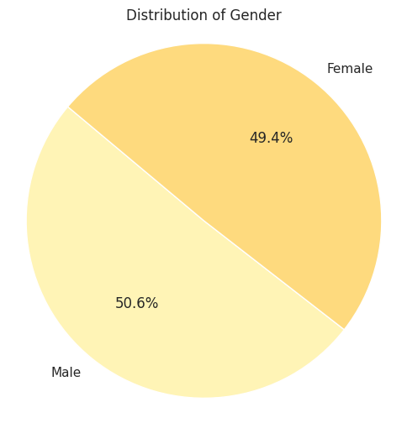
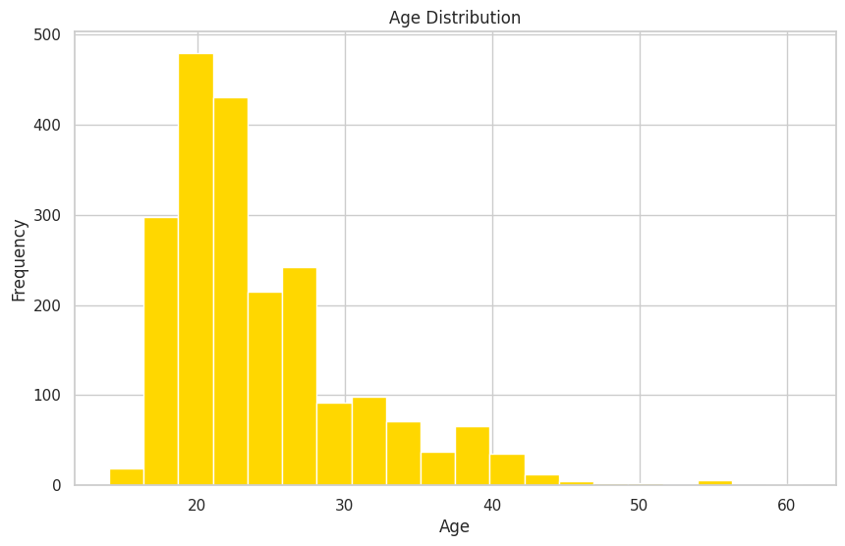
Exploration – Descriptive Statistics
Genders are evenly distributed.
Age ranges from 14 to 61, with a mean age of 24.3.
The dataset predominantly comprises younger individuals, possibly due to the online survey method.
Notes:
Consequently, our analysis is expected to be more representative for the younger demographic group.

Slide 11
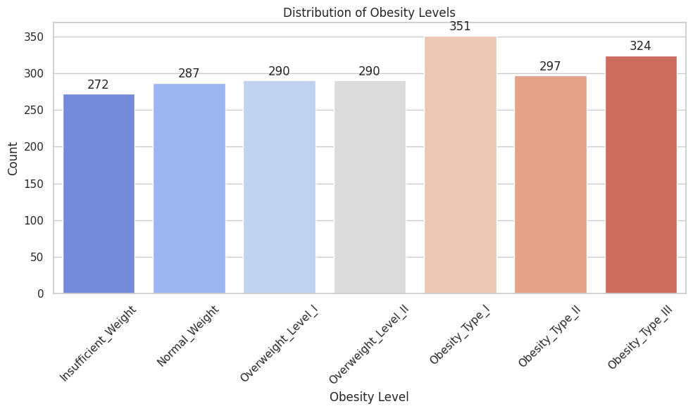
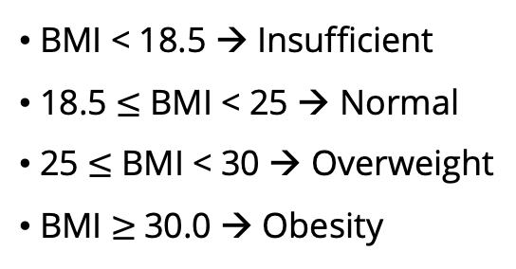
Exploration – Descriptive Statistics
Distribution of weight level

Slide 12
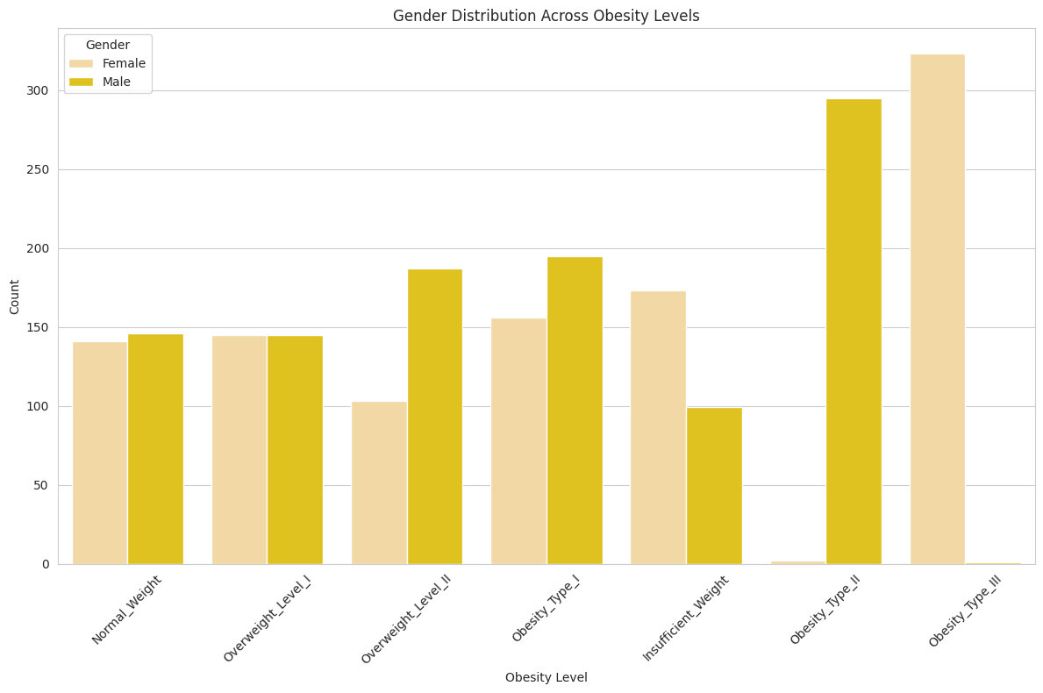
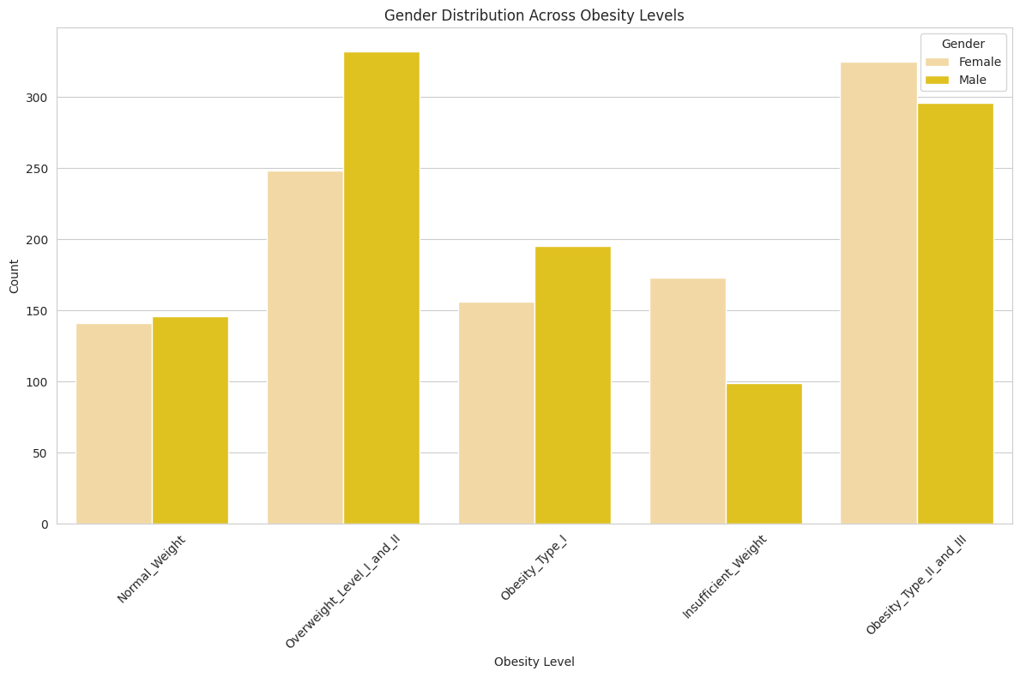
Exploration – Descriptive Statistics
Before
Insights: Splitting the gender categories for obesity distribution reveals a higher prevalence of males in other obesity categories, with noticeable gender bias observed in obesity types II and III.
Conclusion: The data suggests a higher count of females in lower obesity levels. Combining obesity type II and III into one category, as well as grouping overweight categories together, would reduce model complexity.
After

Slide 13
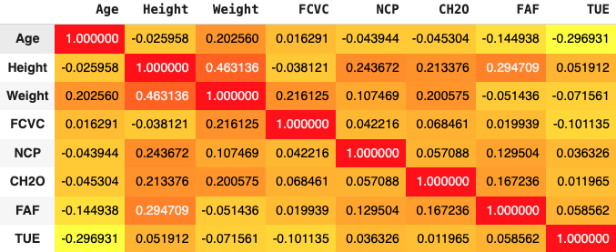
Exploration – Descriptive Statistics
Insights: Height and Weight show a strong positive correlation, which is expected as taller individuals generally weigh more.
Conclusion: Either Height or Weight can be dropped from our key variables, and we decided to remove Weight. Height tends to remain relatively constant for adults, while weight can fluctuate due to various factors.

Slide 14
Exploration – Key Variables
Total Key Variables: 15/16
Demographics
& Health Factors
Eating Habits
Physical Condition
Gender
Frequent consumption of high caloric food (FAVC)
Calories consumption monitoring (SCC)
Age
Frequency of vegetables consumption (FCVC)
Physical activity frequency (FAF)
Height
Number of main meals (NCP)
Time using technology devices (TUE)
Weight
Consumption of food between meals (CAEC)
Transportation mode used (MTRANS)
Family history
Consumption of water daily (CH20)
Smoke
Consumption of alcohol (CALC)

Slide 15
Approach 1: Predict obesity level by predicting BMI
Model 1: Linear Regression​

Slide 16
Model 1: Linear Regression for BMI predication
Model Methodology
BMI is calculated using the height and weight parameters present in the dataset in our original dataset.
This new BMI parameter is used as the target variable to predict the Obesity level of a person.
Linear regression is used to predict BMI with the independent variables defined.
As BMI can be mapped to Obesity levels, we attempted to use a linear model to gain better accuracy predicting a numerical target variable (BMI) and then check the classification of the actual target variable (Obesity).

Slide 17
Model 1: Linear Regression for BMI predication
Model Training
Model Evaluation
Independent Variables
BMI to Obesity Mapping
gender, age, height, family_history_with_overweight, requency_consumption_of_high_calorie_food, frequency_consumption_of_vegetables, number_of_main_meals, consumption_of_food_between_meals, smoker, consumption_of_water_daily, calorie_consumption_monitoring, physical_activity_frequency, time_using_technology_devices, consumption_of_alcohol
Insufficient_Weight : BMI < 18.5
Normal_Weight : 18.5 <= BMI < 24.9
Overweight_Level_I_and_II: 24.9 <= BMI < 29.9
Obesity_Type_I: 29.9 <= BMI < 34.9
Obesity_Type_II_and_III: 34.9 < BMI
Target Variable
Classification Report
BMI
Accuracy, Precision, Recall
Notes:
Insufficient_Weight < 18.5
18.5 <= Normal_Weight < 24.9
24.9 <= Overweight_Level_I_and_II < 29.9
29.9 <= Obesity_Type_I: < 34.9
34.9 < Obesity_Type_II_and_III

Slide 18
Model 1: Linear Regression for BMI predication
Model Assumptions
Linearity: The relationship between the independent variables (predictors) and the dependent variable (response) should be linear. This means that the change in the response variable is proportional to the change in the predictor variables.
No Multicollinearity: The predictor variables should not be highly correlated with each other. Multicollinearity can lead to unstable estimates of the regression coefficients and makes it difficult to interpret the effects of individual predictors.

Slide 19
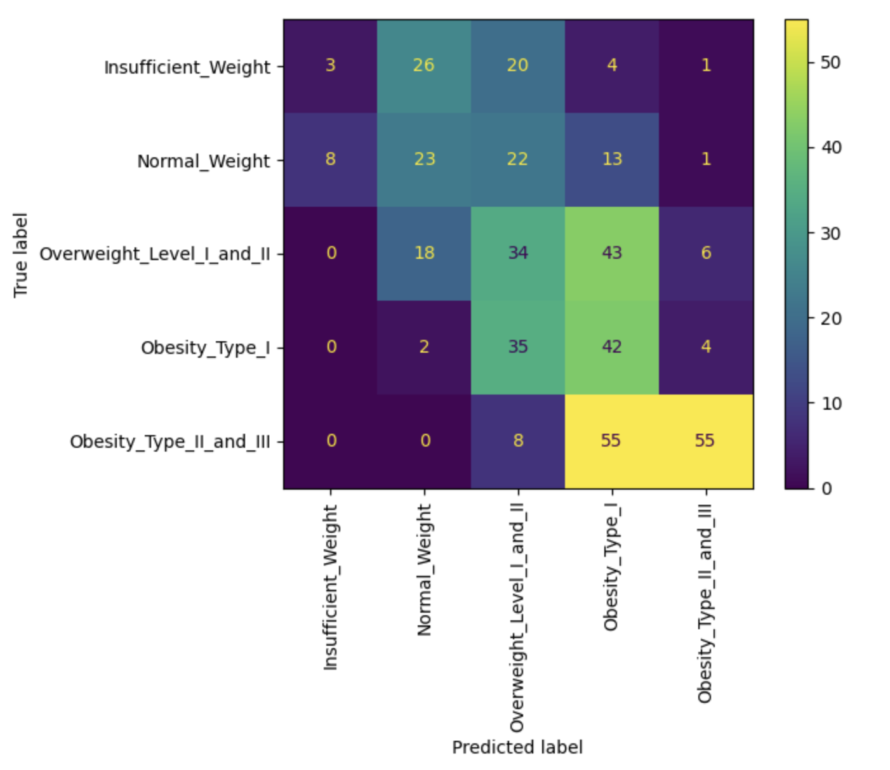
Linear Model - Evaluation
Model Accuracy: 37%
Weighted Precision: 43%
Weighted Recall: 37%
The model performs well in predicting only Obesity Type I
The model performs relatively poorly predicting all other variables.

Slide 20
Approach 2: Classify the different obesity levels
Model 2: Ordinal Logistic Regression​
Model 3: CART Model

Slide 21
Model 2: Ordinal Logistic Regression
Model Methodology
The target variable of Obesity Level is converted into an ordinal variable in the following order: Insufficient weight , Normal Weight, Overweight level 1 and 2, Obesity level 1 and Obesity level 2 and 3.
We used stratify option while splitting the data in train and test to make sure that there is not class imbalance in the test set.
The model was chosen to classify with a better accuracy as the target variable can be converted in an ordinal fashion without losing any meaning.
We used the following parameters for logistic regression:
Method: BFGS (Algorithm that iteratively tries to reduce the loss function)

Slide 22
Model 2: Ordinal Logistic Model for Obesity Classification
Model Training
Model Evaluation
Independent Variables
gender, age, height, family_history_with_overweight, requency_consumption_of_high_calorie_food, frequency_consumption_of_vegetables, number_of_main_meals, consumption_of_food_between_meals, smoker, consumption_of_water_daily, calorie_consumption_monitoring, physical_activity_frequency, time_using_technology_devices, consumption_of_alcohol
Classification Report
Accuracy, Precision, Recall
Target Variable
Obesity Level (Ordinal)
Notes:
Insufficient_Weight < 18.5
18.5 <= Normal_Weight < 24.9
24.9 <= Overweight_Level_I_and_II < 29.9
29.9 <= Obesity_Type_I: < 34.9
34.9 < Obesity_Type_II_and_III

Slide 23
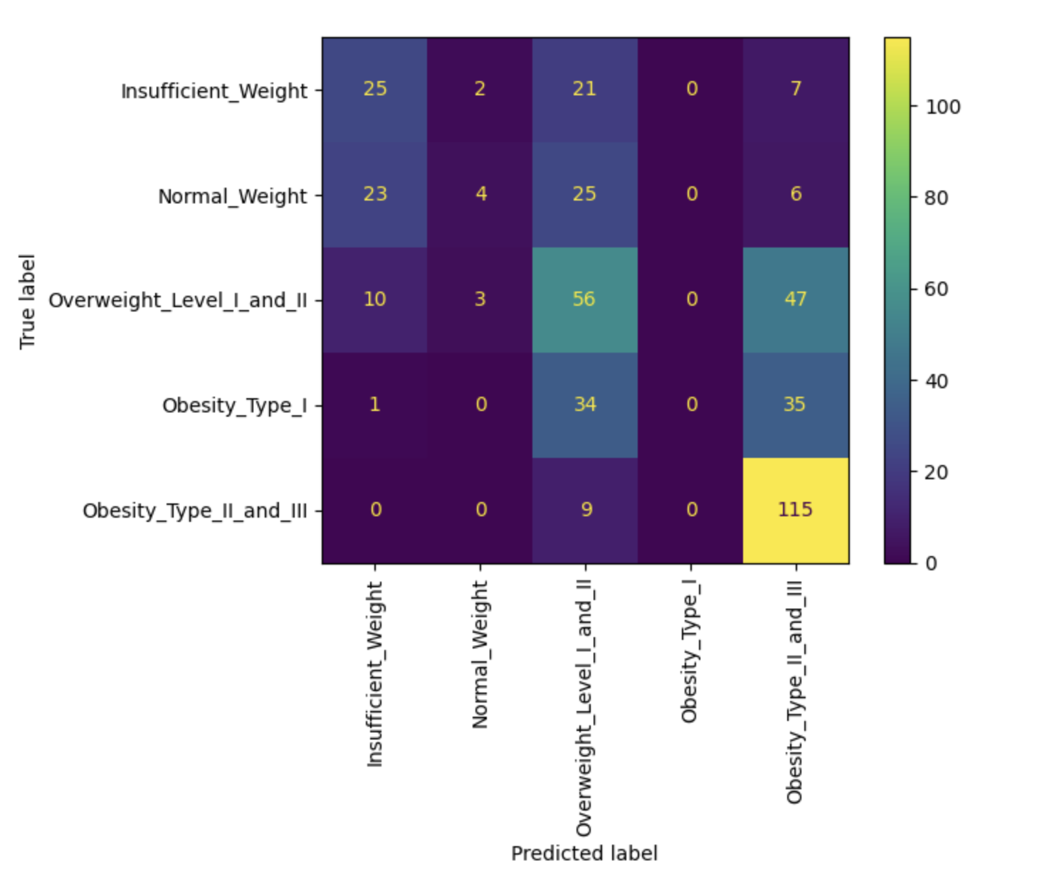
Ordinal Logistic Regression- Evaluation
Model Accuracy: 47%
Weighted Precision: 38%
Weighted Recall: 47%
The model performs well in predicting Insufficient Weight, Obesity Type II and III & Overweight Level I and II
The model performs relatively poorly predicting Normal Weight and Obesity level I

Slide 24
Model 3: CART Model
Model Methodology
Decision Tree Model
Excluding BMI and Weight, the remaining features are used as independent variables
Obesity Level as dependent variable
Set 20% of total rows as test set, and applied stratify option while splitting the data in train and test
Standardized independent variables that are in numerical format, that is, scaling those to a standard normal distribution with a mean of 0 and a variance of 1
Parameter Tuning
Use Grid Search to find the best decision tree model
During this process, we tuned three parameters:
max_depth: The maximum depth of the tree, used to control the growth depth of the tree
min_samples_split: The minimum number of samples required for node splitting
min_samples_leaf: the minimum number of samples required for leaf nodes
The train set is divided into 5 parts, and each part is used as a validation set in turn for cross-validation.

Slide 25
Model 3: CART Model
Rebuild the model
Rebuild the model with the best parameter combination obtained.
The best parameters are:
max_depth: 15
min_samples_leaf: 1
min_samples_split: 2
Use the test set to evaluate the model – Run Classification Report
Notes:
How are you addressing it: What methodology are you applying? Why does it fit?
Model details: What model are you using (e.g. if it's a regression model, write down specification (what variables are included).
Assumptions: Does your data satisfy the assumptions of the proposed model?
Result: Model output with visualization (if appropriate) and interpretation of the results.

Slide 26
Model 3: CART Model
Model Assumptions
Independent variables are continuous features and categorical features.
Features are independent of each other, that is, the splitting of features is not affected by other features.
There is no linear relationship between features.

Slide 27
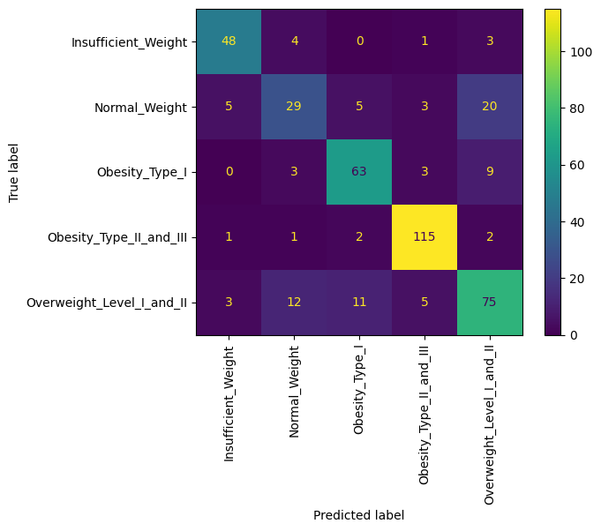
CART Model - Evaluation
Model Accuracy: 78%
Weighted Precision: 77%
Weighted Recall: 78%
The model performs well in predicting Insufficient Weight, Obesity Type I, II and III
The model performs relatively poorly in predicting Normal Weight & Overweight Level I and II

Slide 28
Summary
 | Linear Regression | Ordinal Logistic Regression
Accuary | 37% | 47% | 78%
Weighted Precision | 43% | 38% | 77%
Weighted Recall | 37% | 47% | 78%
CART

Slide 29




Summary
Top 5 key factors influencing obesity levels
Frequency consumption of vegetables
Time using technology devices
Number of main meals
Age
Height
Importance: 15.4%
Importance: 14.5%
Importance: 12.5%
Importance: 10.4%
Importance: 8.9%

Slide 30

Thank you! Any questions?

